Slide 1

Grid - Based Password Authentication System
Presented By:
1.Nallapaneni DurgaPrasad (19481A1281)
2.Thallapureddy Praveen Kumar Reddy (19481A12B6)
3.Pathuri Guna Rajesh (19481A1295)
4.Mohammad Asmathulla (19481A1272)
Under the guidance of:
Mr. K.Srikanth, M.Tech
Assistent Professor
Department of Information Technology
SESHADRI RAO GUDLAVALLERU ENGINEERING COLLEGE
(An Autonomous Institute with Permanent Affiliation to JNTUK, Kakinada)
Seshadri Rao Knowledge Village, Gudlavalleru – 521356, Krishna District

Slide 2

Objective
To develop a password authentication system that is easier for a user to remember password and increase the level of security.

Slide 3
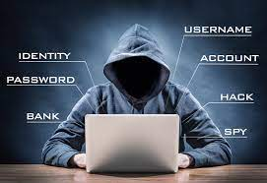

Introduction
With increasing technical advancements the world is becoming digital at a high pace and everything is happening online.
From paying your bills to ticket bookings to paying the person sitting next to you, you prefer to pay online.
Not only payments but all activities, be it, communication through e-mails and messaging apps, keeping your documents in a digital locker etc happen online.
With everything turning online, the risk of cybercrimes and privacy breaches is also increasing.

Slide 4

Passwords play a huge role in keeping your data safe online as well as offline platforms.
Passwords are the default method of authentication to get access to our accounts.
Using images as passwords we can ensure more security than traditional authentication methods

Slide 5
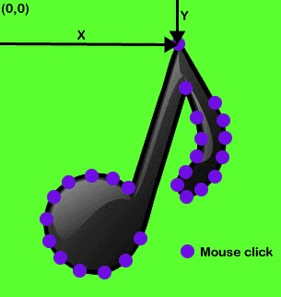
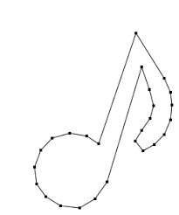
Selecting coordinates for authentication
Abstract
Graphical passwords refer to using pictures (also drawings) as passwords.
In theory, graphical passwords are easier to remember, since humans remember pictures better than words .
Also, they should be more resistant to brute force attacks, since the search space is practically infinite.
A recall-based graphical password approach was introduced by Greg Blonder in 1996 . In this approach, a user create a password by clicking on several locations on an image. A user is asked to reproduce something that he created or selected at the registration stage. a user can click any point in an image to create the password and a tolerance around each pixel is calculated. During authentication, the user has to select the points within the tolerance in the correct sequence to login.

Slide 6
Software Requirements Specification
Project scope
The scope of this project is to develop a password authentication system that makes the user to
easily remember his/her password and increase the level of security.
We will have a database server that will save registration info or authenticate user based on already saved credentials.
We hope to provide a comfortable user experience
User Interfaces
Front end : HTML,CSS,JAVASCRIPT
Back end : Mysql, JSP/PHP

Slide 7




Hardware Interfaces
Windows
A browser that supports HTML and Javascript
Communication Interfaces
This project supports all types of web browsers
We use HTML,CSS and javascript and therefore there will be no system compatibility issues

Slide 8
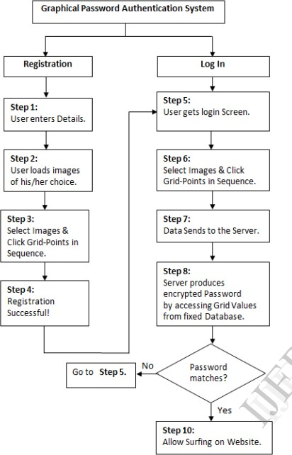
Flow chart

Slide 9
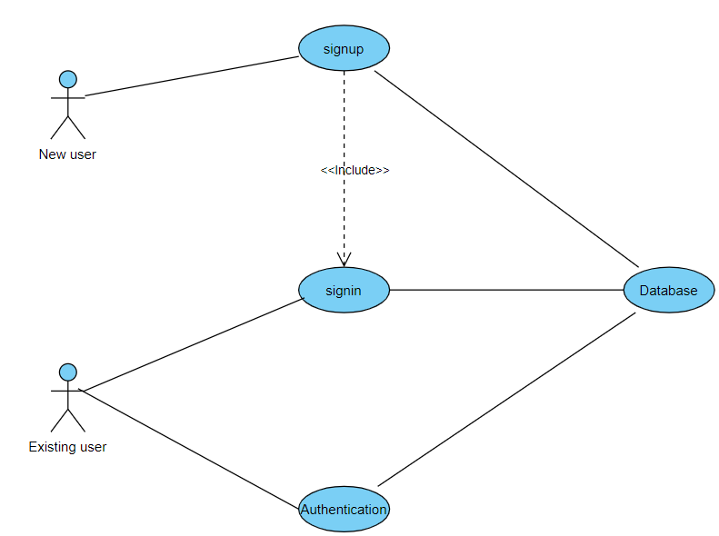
Use case diagram

Slide 10
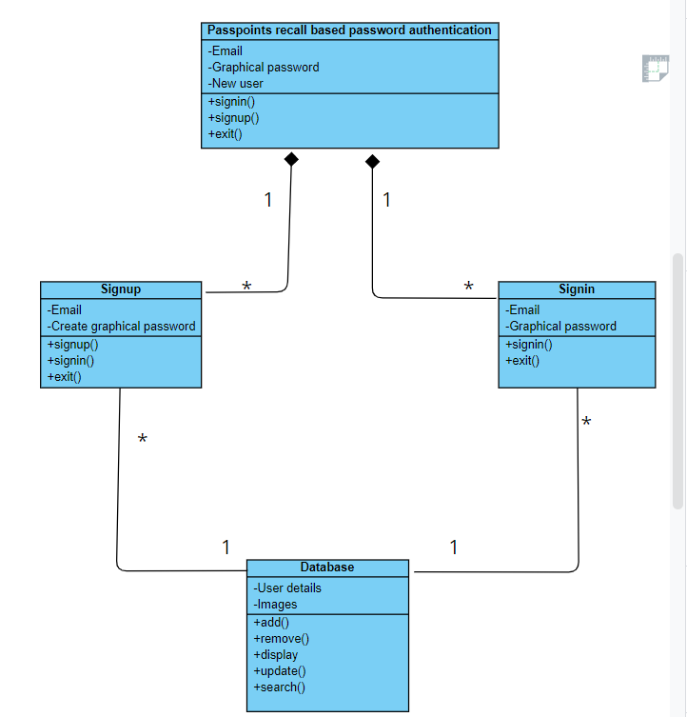
Class diagram

Slide 11
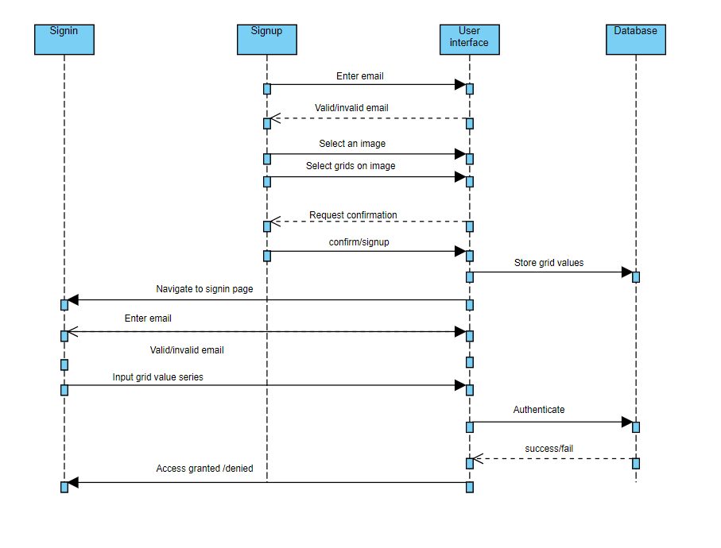
Sequence diagram

Slide 12
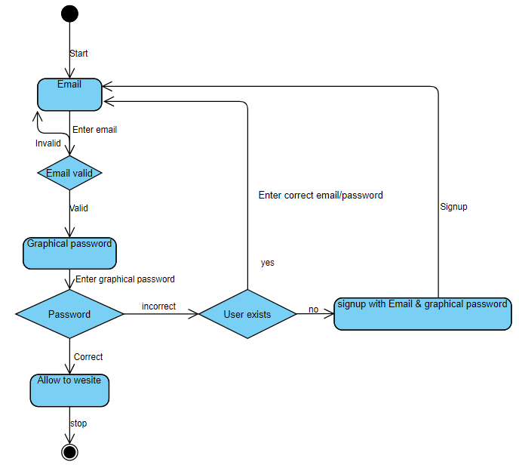
State chart

Slide 13
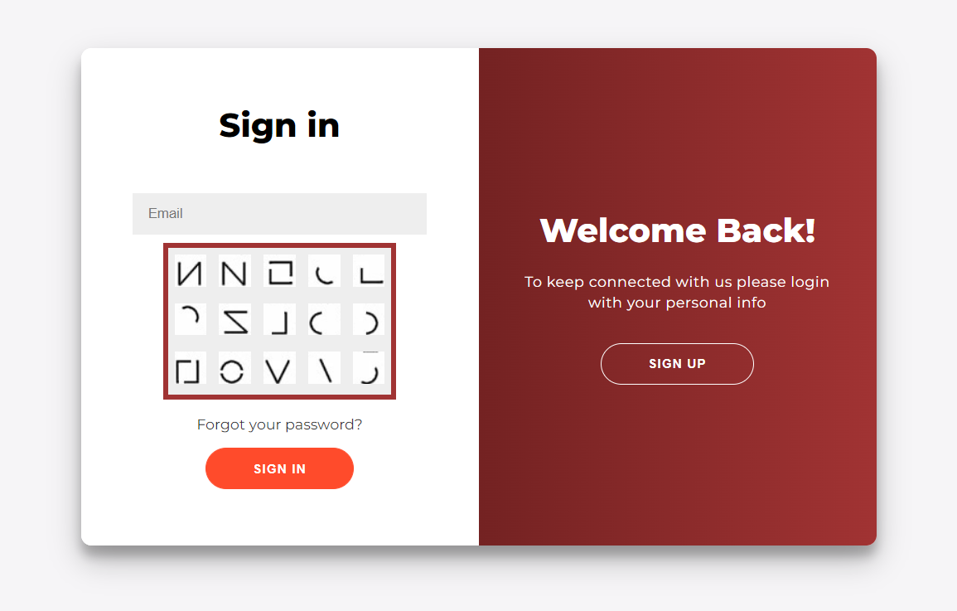
Signin/Login page

Slide 14
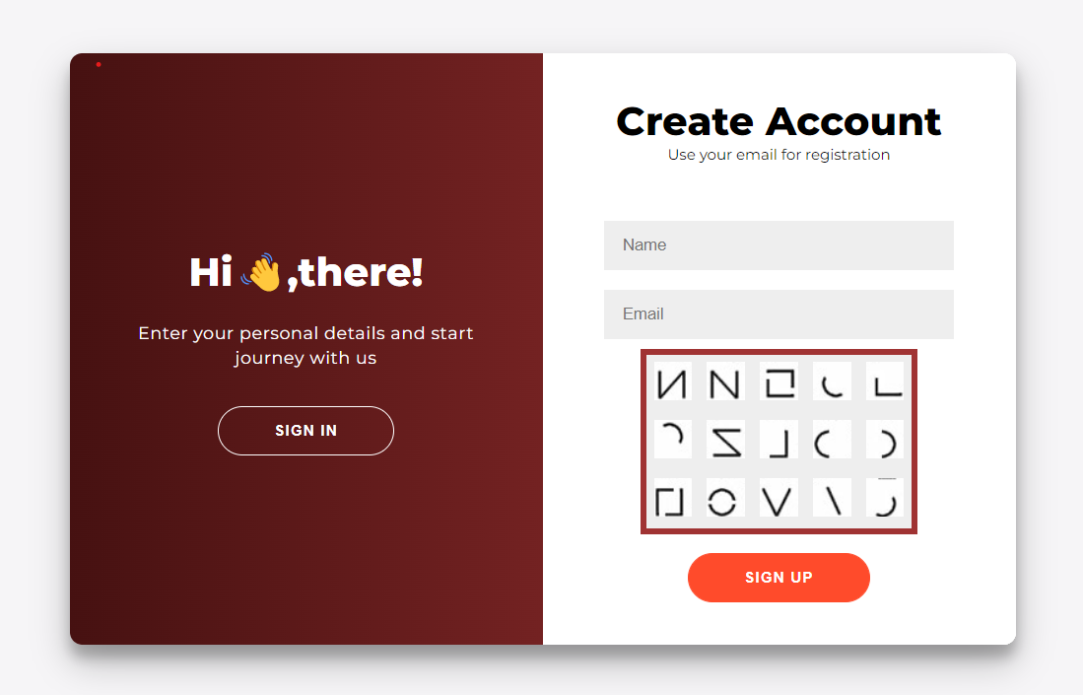
Signup page

Slide 15
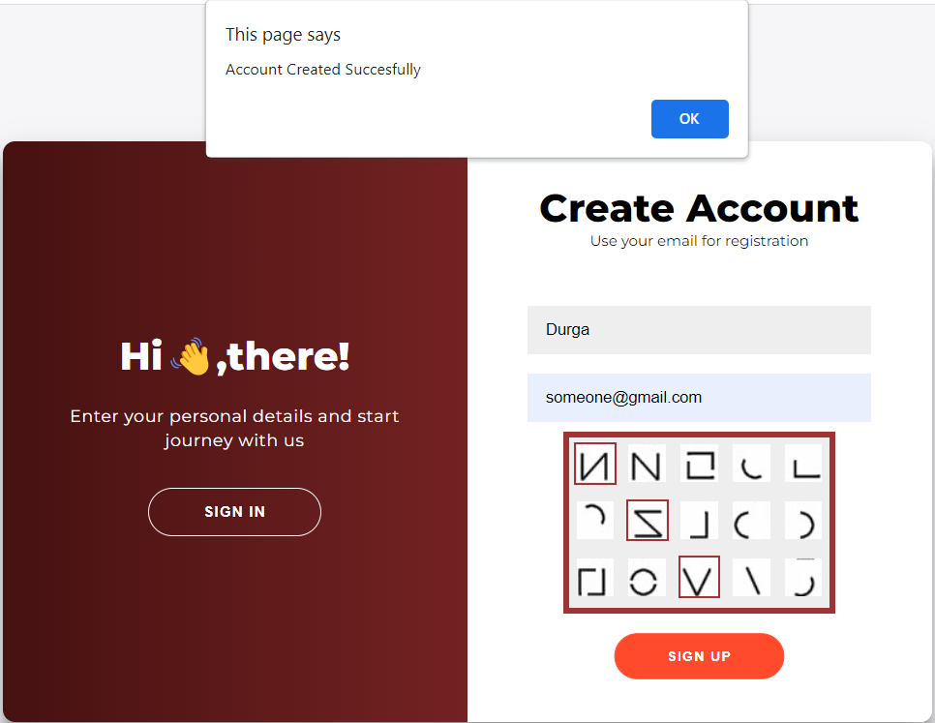
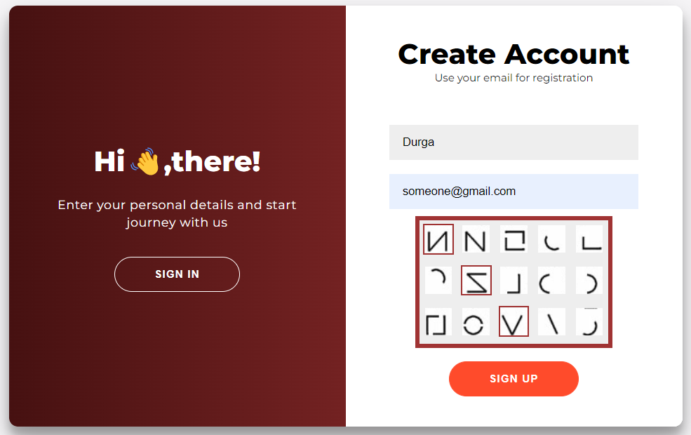
Signup process

Slide 16
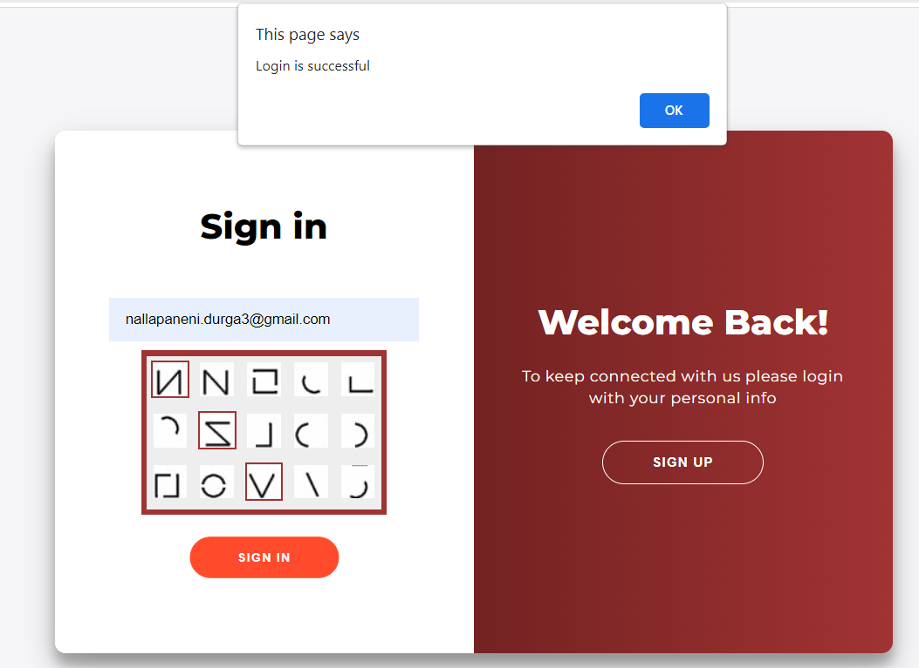
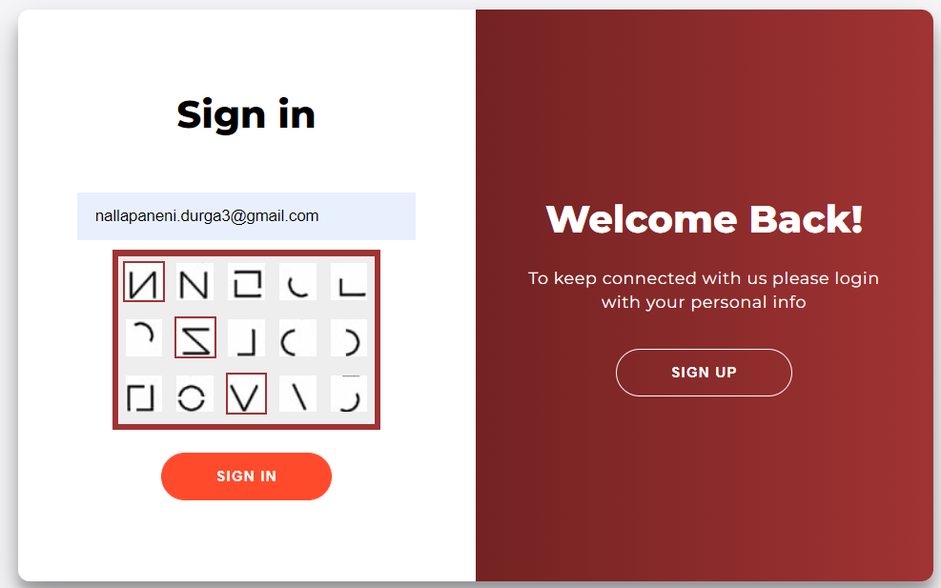
Sign in process

Slide 17
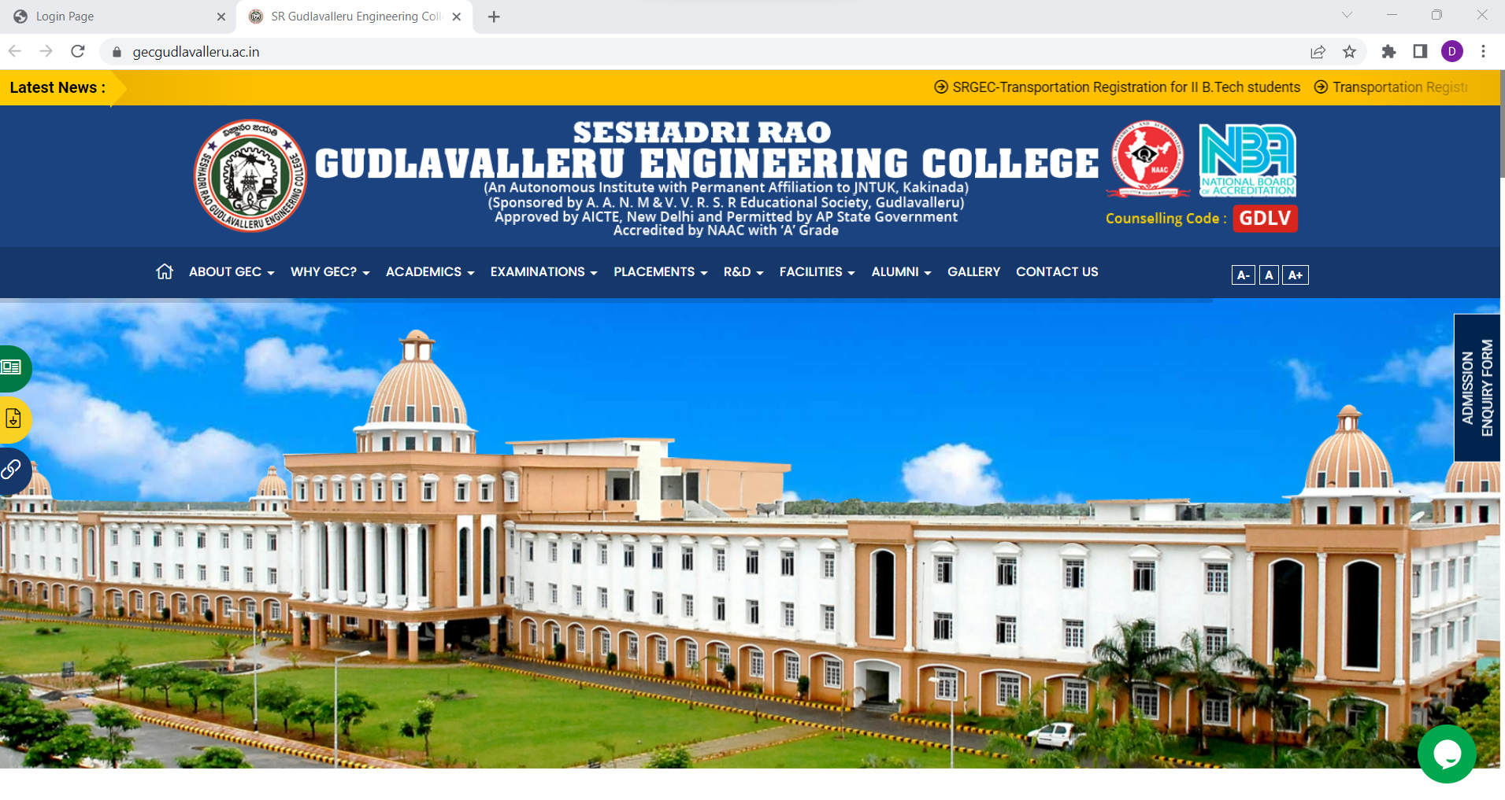
Upon successful login/signup software allows user to access the website

Slide 18
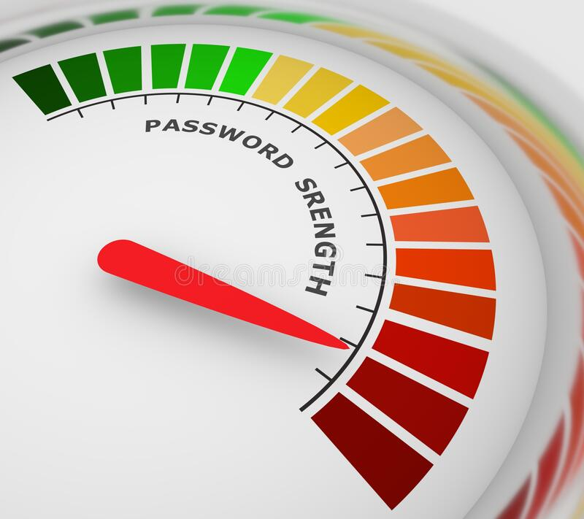
Conclusion
Graphical passwords are an alternative to textual alphanumeric
password. It satisfies both conflicting requirements i.e. easy to
remember and security.

Slide 19


